Slide 1



Robotics Club - Workshop 1

Slide 2

Robotics Club - Workshop 1

Slide 3


Table of Contents
1. What is a Robot?
2. Introduction to Arduino
3. Digital vs Analog
4. Components of Arduino
5. Sensors and Actuators
6. Setting Up First Project

Slide 4


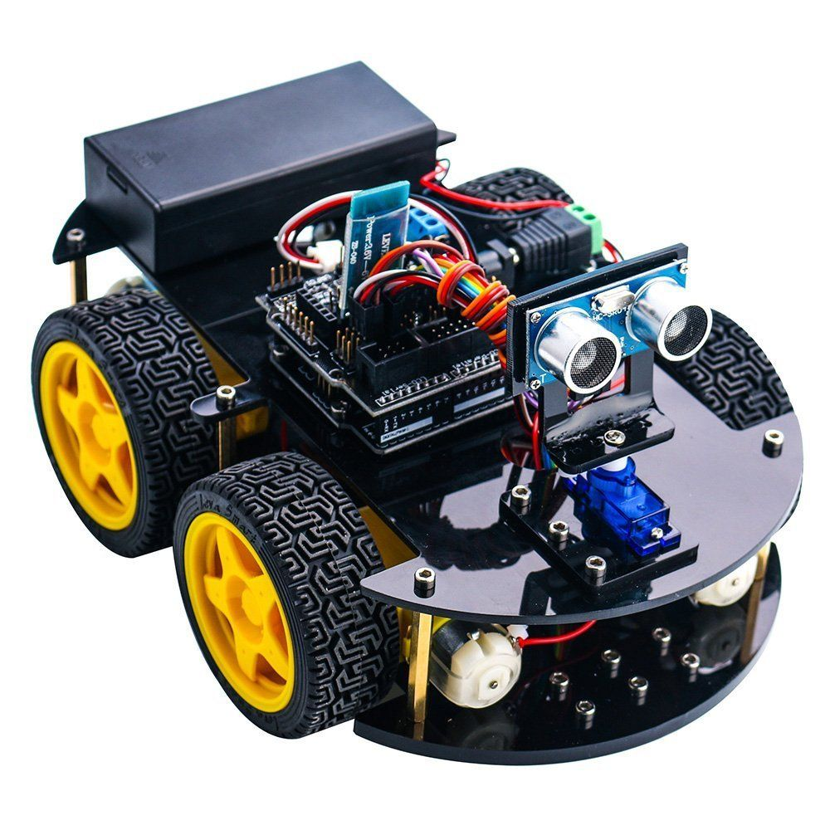
1. What is a Robot?
Humanoid Robot
Stationary Robot
Mobile Robot

Slide 5

1. What is a Robot?
Environmental
Sensor
Controller
Actuator

Slide 6
2. Introduction to Arduino
What is Arduino?
Arduino is an open-source platform used for building electronics projects. It consists of both a programmable circuit board (microcontroller) and software (Arduino IDE) to program it.

Slide 7
2. Introduction to Arduino
Why Learn Arduino?
Arduino makes electronics easy to learn because it allows users to control hardware with simple code. It’s widely used in DIY projects, education, and even in professional prototyping.

Slide 8
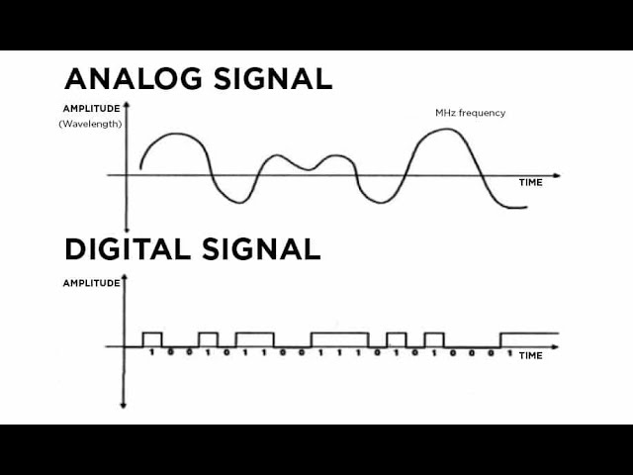
3. Digital vs Analog
Digital Signal
Analog Signal

Slide 9
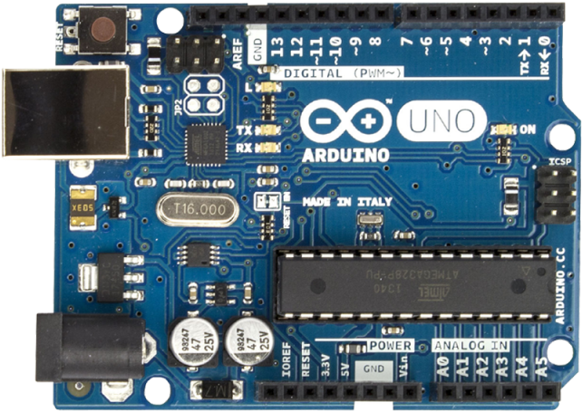

4. Components of Arduino
3. USB TO SERIAL CHIP
4. DIGITAL PINS
2. USB PORT
1. MICROCONTROLLER
7. 5V/3.3V
5. ANALOG PINS
8. GND
6. VIN

Slide 10
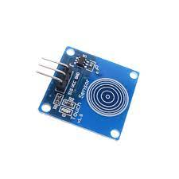
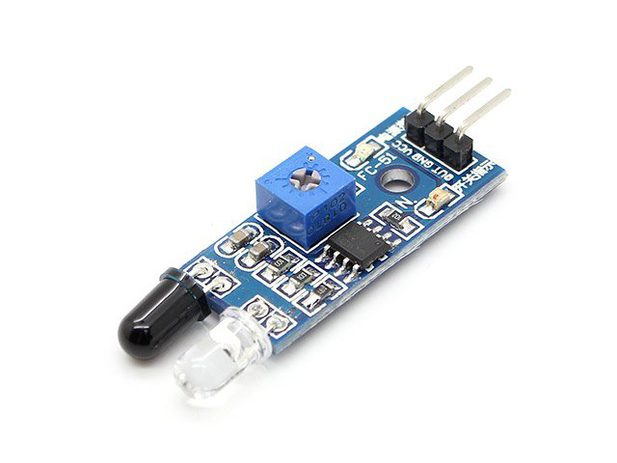
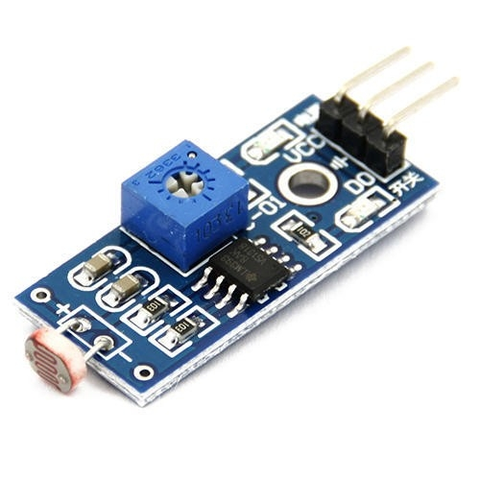
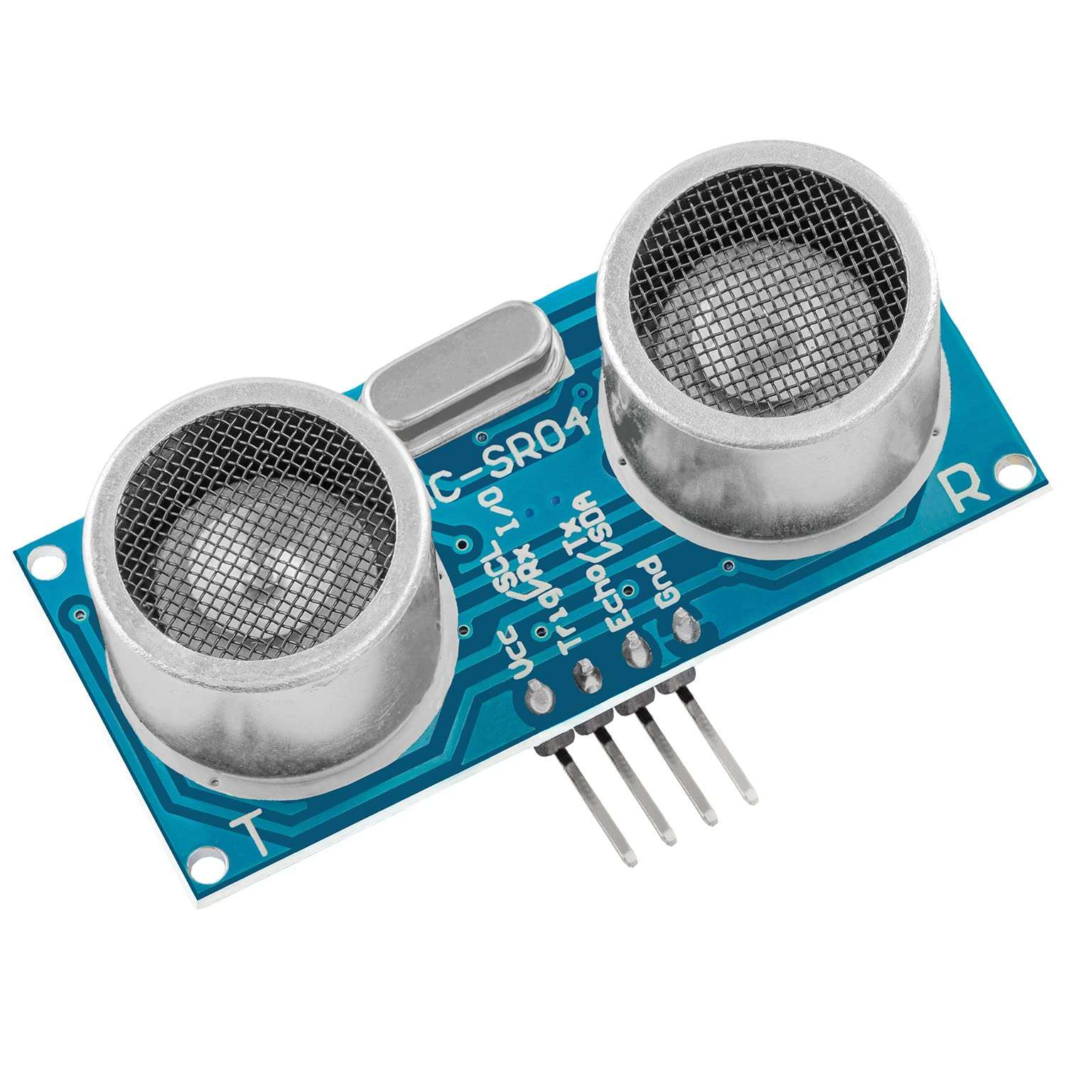
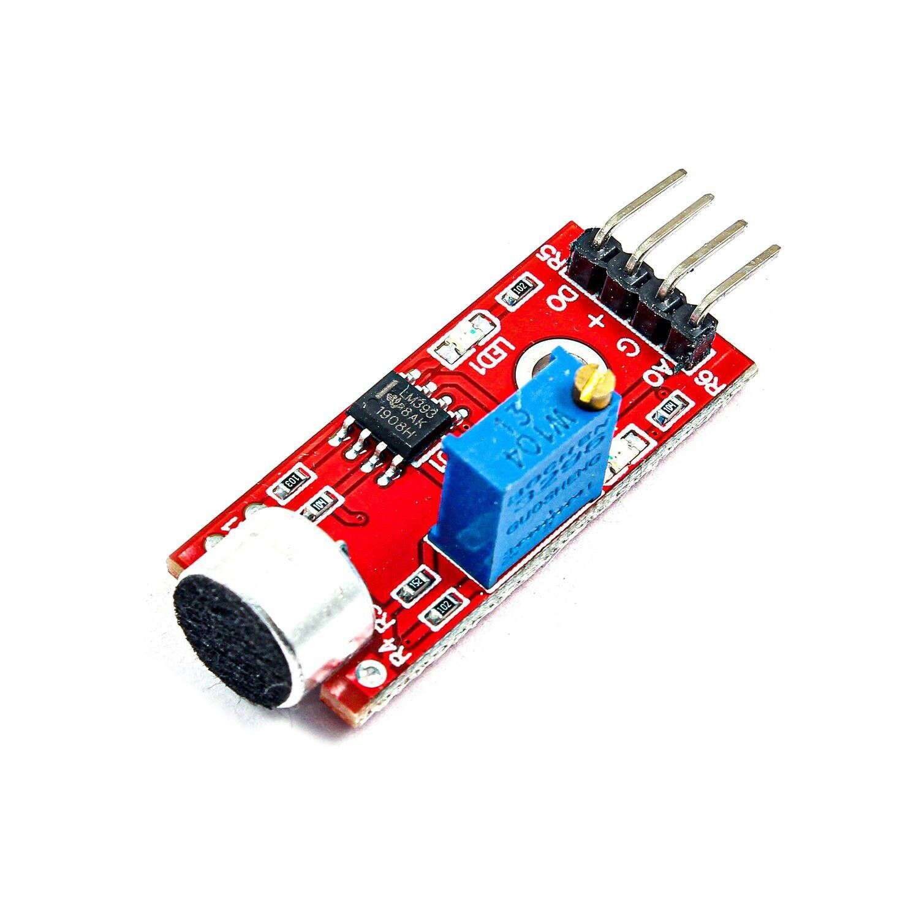
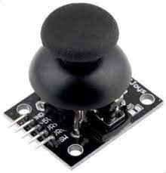
5. Sensors and Actuators
1
2
3
IR (InfraRed) Sensor
LDR (Light Dependent Resistor) Sensor
Touch Sensor
4
5
6
Ultrasonic Sensor
Sound Sensor
Joystick Module

Slide 11
6. Setting Up First Project
Understanding the Components
Step 1:
Circuit Setup
Step 2:
Code
Step 3:
Upload the Code
Step 4:

Slide 12
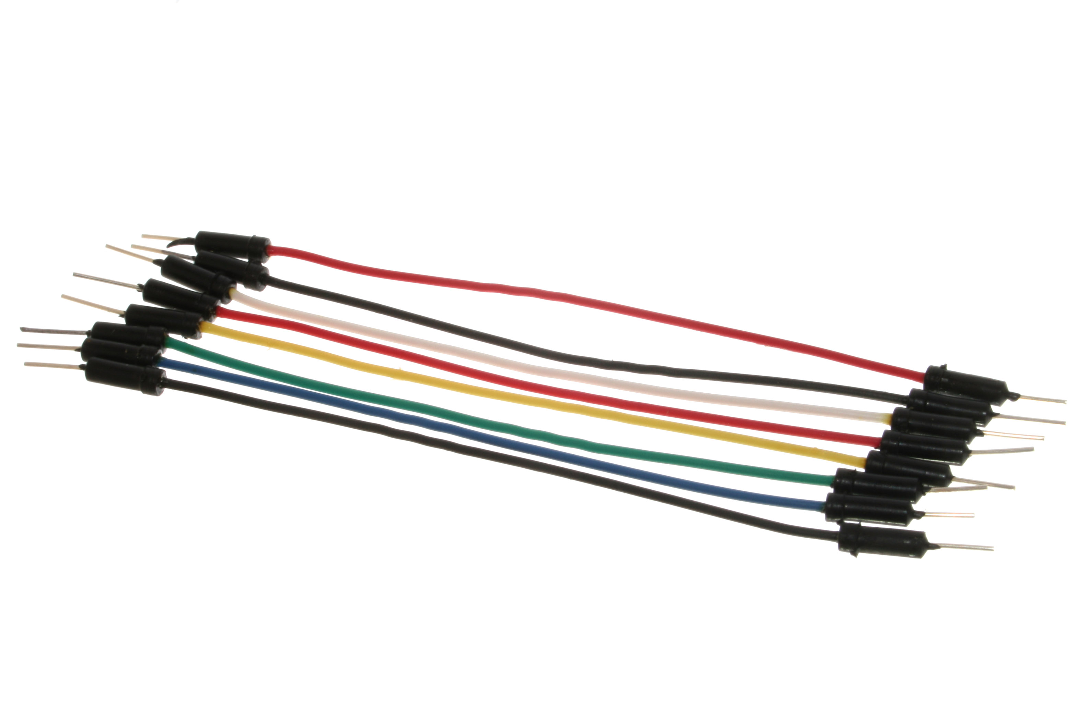
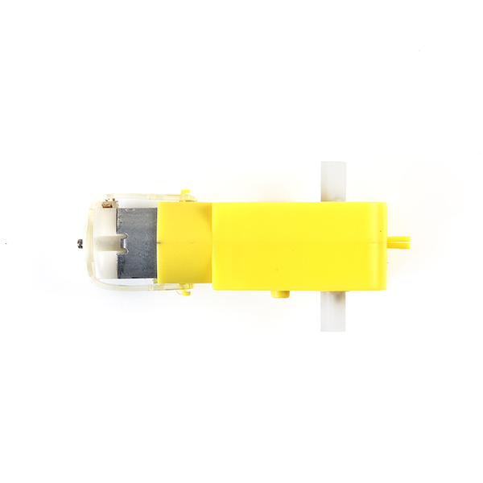
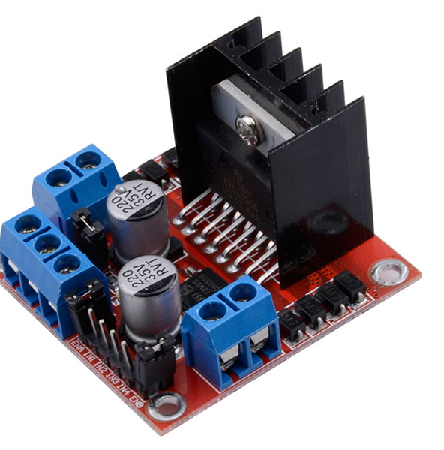
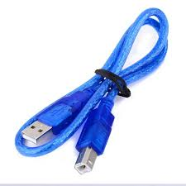
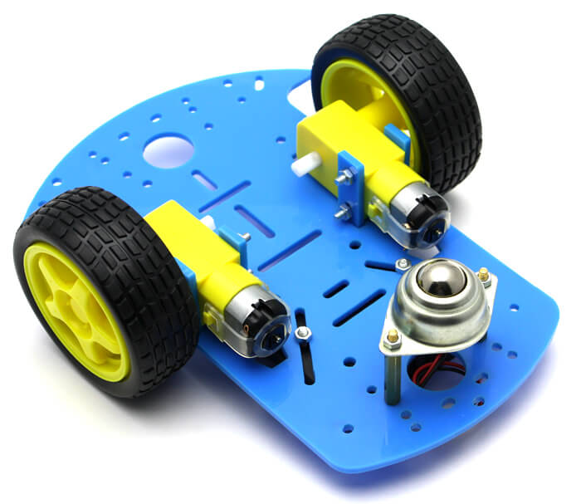
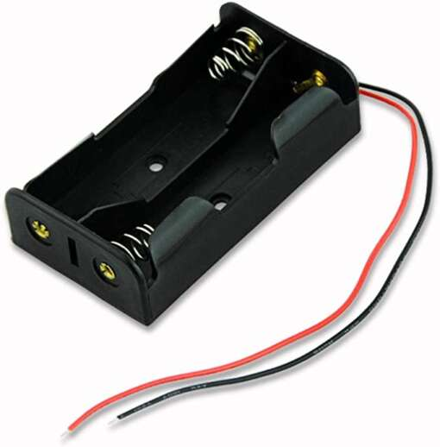
6. Setting Up First Project
Understanding the Components
Step 1:
1
2
3
4
Arduino board
DC Motor
L298N Motor Driver Module
Jumper wires
5
6
7
USB cable
Mobile Robot Chassis Kit
Battery

Slide 13
6. Setting Up First Project
Understanding the Components
Step 1:
1. Why Motor Driver Module?
A Motor Driver is an electronic component that controls the operation of DC motors, allowing you to control the speed and direction of the motors using a low-power microcontroller, like an Arduino.
The L298N is a dual H-Bridge motor driver. An H-Bridge is a circuit that allows you to control the direction of a DC motor.

Slide 14
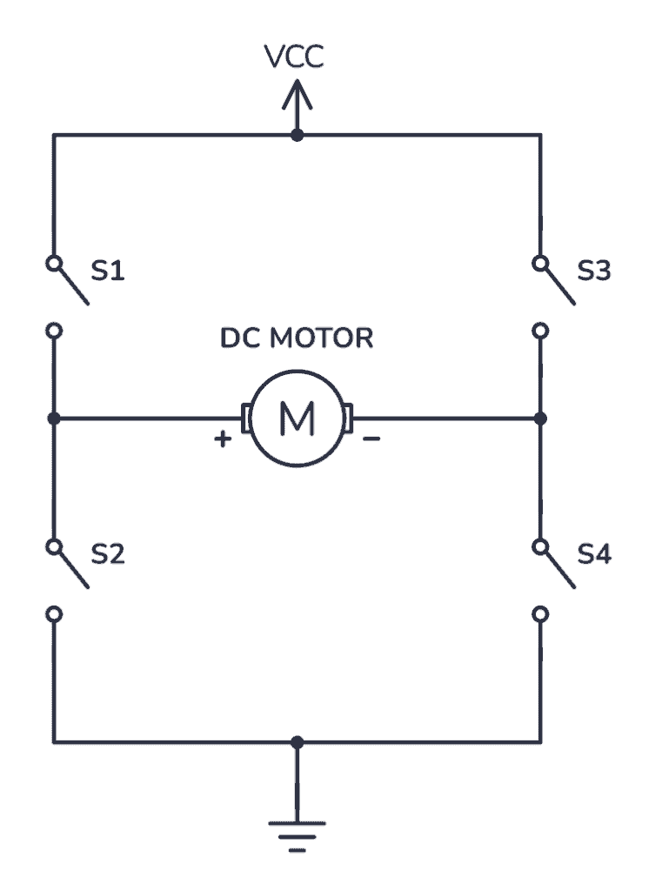
6. Setting Up First Project
Understanding the Components
Step 1:
H-Bridge DC Motor Control
For controlling the rotation direction, we just need to inverse the direction of the current flow through the motor, and the most common method of doing that is by using an H-Bridge. An H-Bridge circuit contains four switching elements, transistors or MOSFETs, with the motor at the center forming an H-like configuration. By activating two particular switches at the same time we can change the direction of the current flow, thus change the rotation direction of the motor.

Slide 15
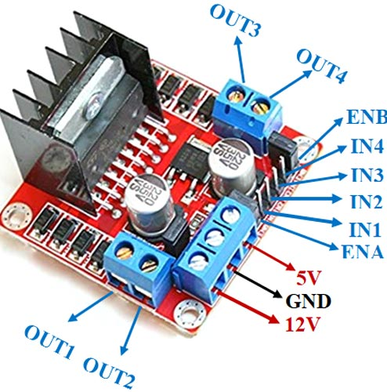
6. Setting Up First Project
Understanding the Components
Step 1:
2. Pins and Connections of L298N
[1] Input Control Pins:
[A] IN1 and IN2 (for Motor 1)
[B] IN3 and IN4 (for Motor 2)
Role: Control the direction of Motor 1 / Motor 2 (forward/reverse).
Depending on the HIGH/LOW combination of IN1, IN2, IN3 and IN4 , Motor 1/ Motor 2 can move forward or backward.

Slide 16
6. Setting Up First Project
Understanding the Components
Step 1:
2. Pins and Connections of L298N
[2] Enable Pins (Speed Control):
These pins control the speed of the motors using PWM signals from the Arduino.
[A] ENA (Enable A): This pin enables or disables Motor 1. By connecting it to a PWM pin on the Arduino and using analogWrite(), you can control the speed of Motor 1.
[B] ENB (Enable B): This pin enables or disables Motor 2. It can also be connected to a PWM pin to control Motor 2's speed.

Slide 17
6. Setting Up First Project
Understanding the Components
Step 1:
2. Pins and Connections of L298N
[3] Power Pins:
[A] 12V
[B] GND (Ground)
[C] 5V
[4] Motor Control Pins:
[A] OUT1 and OUT2
[B] OUT3 and OUT4

Slide 18
6. Setting Up First Project
Understanding the Components
Step 1:
3. How the L298N Works
Motor Direction
Each motor has two input pins (e.g., IN1/IN2 for Motor 1). By setting one pin HIGH and the other LOW, you control the direction in which the motor spins.
For example:
IN1 HIGH, IN2 LOW → Motor moves forward.
IN1 LOW, IN2 HIGH → Motor moves backward.
Motor Speed
The ENA and ENB pins are used to control the speed of the motors using PWM. By applying a PWM signal (with a value between 0 and 255) to these pins, you can vary the motor speed. A value of 0 turns the motor off, and 255 runs it at full speed.

Slide 19
6. Setting Up First Project
Circuit Setup
Step 2:
Right Motor (Motor 1)
IN1 (Motor 1) ← Arduino Pin 3
IN2 (Motor 1) ← Arduino Pin 4
ENA (Motor 1) ← Arduino Pin 2 (PWM Pin)
OUT1 and OUT2 ← Motor 1 Pin 1-2
Left Motor (Motor 2)
IN3 (Motor 2) ← Arduino Pin 5
IN4 (Motor 2) ← Arduino Pin 6
ENB (Motor 2) ← Arduino Pin 7 (PWM Pin)
OUT3 and OUT4 ← Motor 2 Pin 1-2
Battery
The positive terminal ← 12V pin on the L298N.
The negative terminal ← GND pin on the L298N and Arduino.
5V terminal ← Arduino Pin 5V/VIN

Slide 20
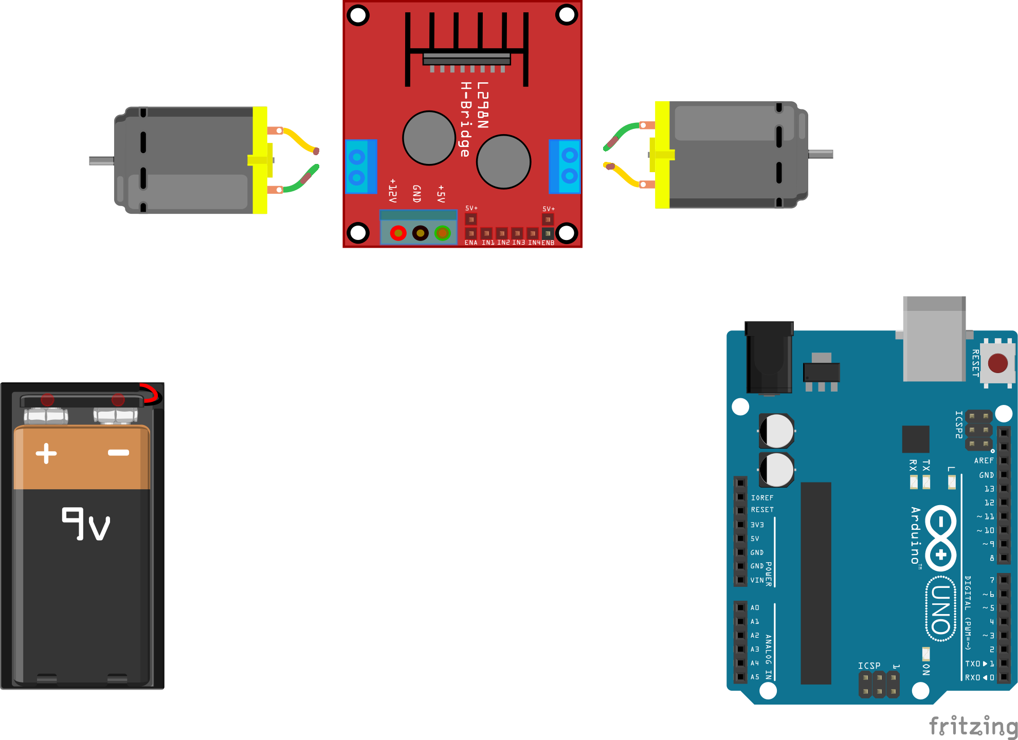

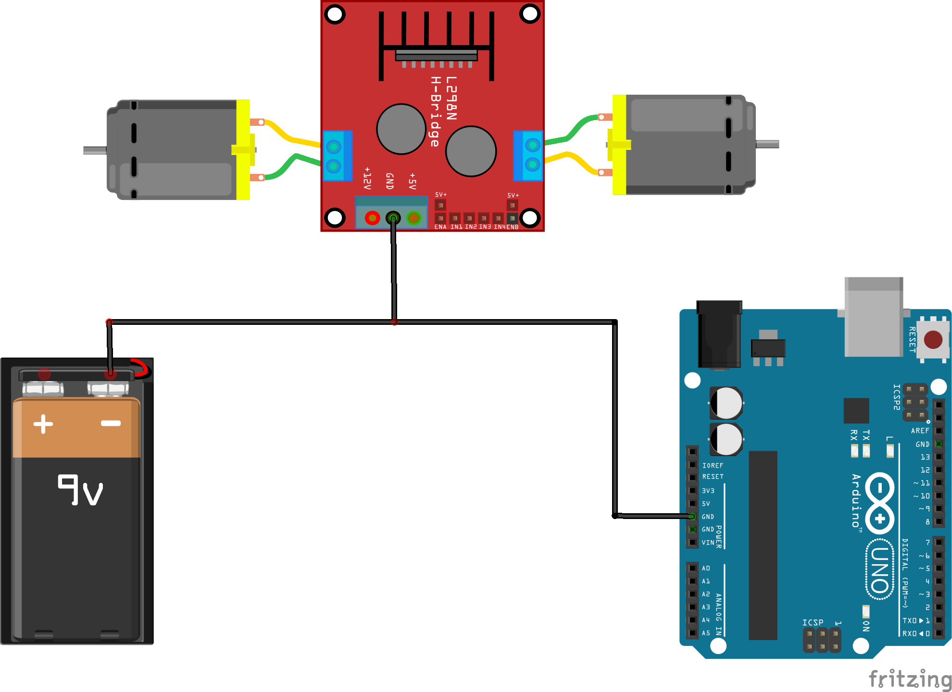
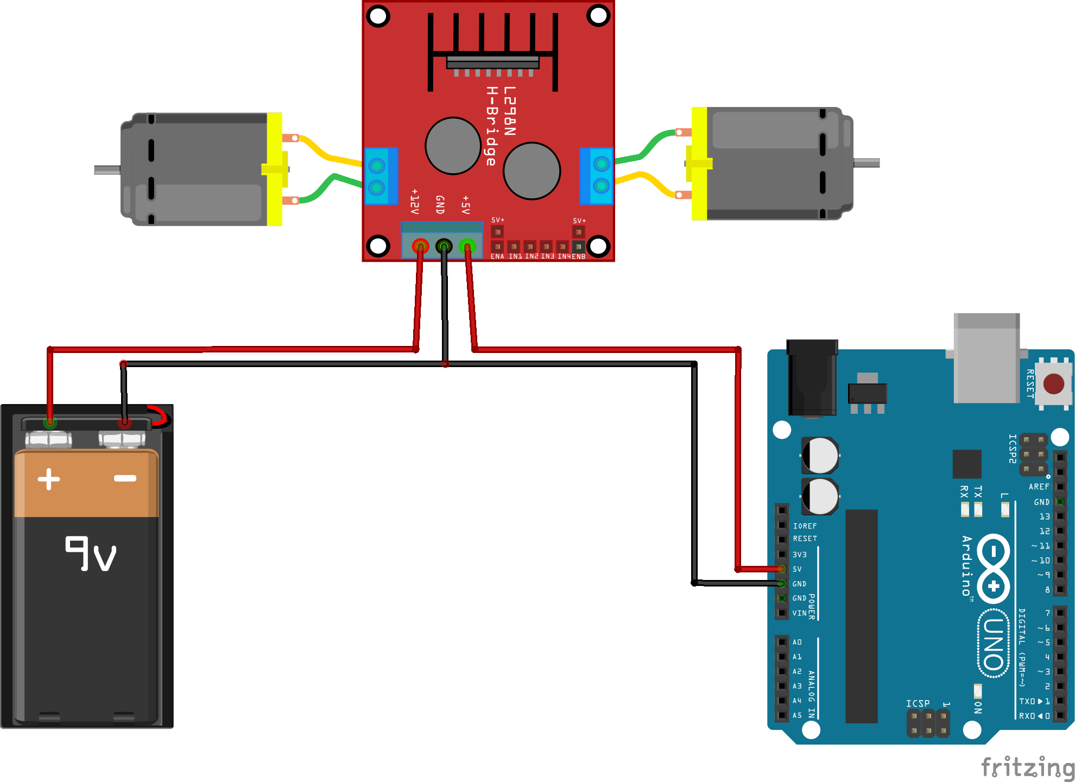
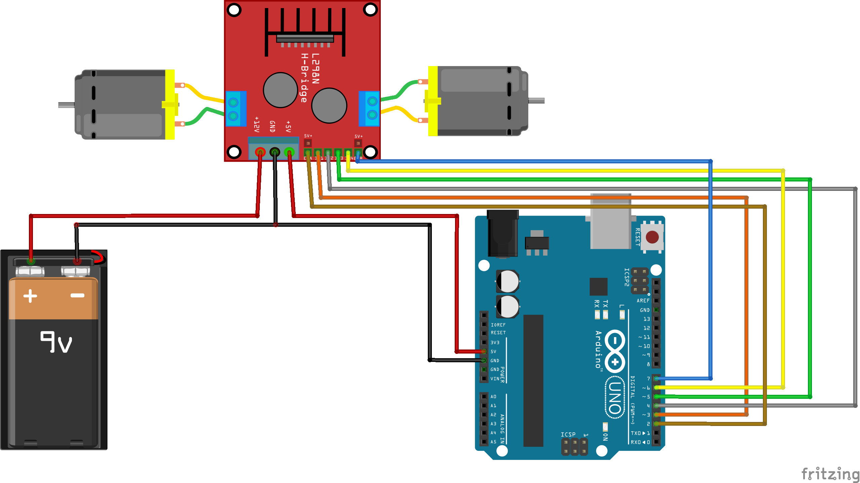
6. Setting Up First Project
Circuit Setup
Step 2:

Slide 21
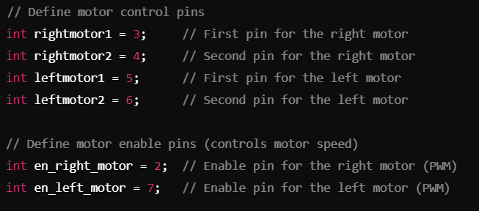
6. Setting Up First Project
Code
Step 3:

Slide 22
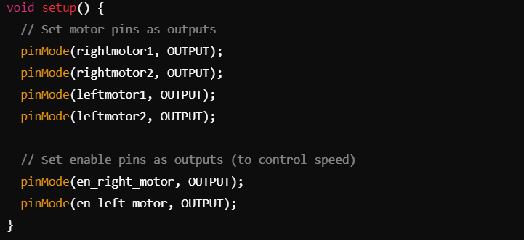
6. Setting Up First Project
Code
Step 3:

Slide 23
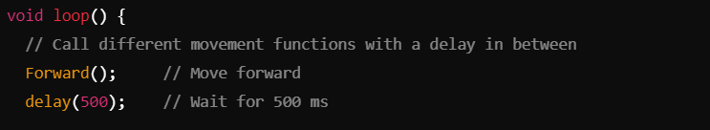
6. Setting Up First Project
Code
Step 3:

Slide 24
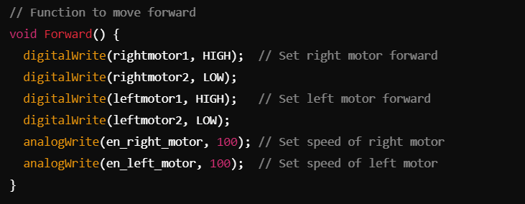
6. Setting Up First Project
Code
Step 3:

Slide 25
6. Setting Up First Project
Upload the Code
Step 4:
Open the Arduino IDE.
Connect the Arduino board.
Select the correct board and port:
Go to Tools > Board and select the correct Arduino model.
Go to Tools > Port and select the COM port.
Copy and paste the code into the Arduino IDE.
Click the Upload button.

Slide 26

Drive Link

Slide 27
WhatsApp
Instagram
LinkedIn
Facebook
Thank You.
Youssef Adel
Robotics Club - Workshop 1

